Slide 1
High-Level Synthesis Basics
Dawei Gu
david-xdu@foxmail.com
www.david-luge.cn

Slide 2
Outline
What’s HLS?
Why HLS?
Optimizing the Design
Throughput
Latency
Area
Logic
Managing Interfaces
Interface Synthesis Reference(optional)
How to use HLS?
What’s more?

Slide 3
What’s HLS?
High-Level Synthesis(HLS) tool transforms a C specification into a register transfer level(RTL) implementation that you can synthesize into a FPGA.
Is it really that simple?

Slide 4
Why HLS?
High-level synthesis bridges hardware and software domains, providing the following primary benefits:
Improved productivity for hardware designers.
Improved system performance for software designers.
Using a high-level synthesis design methodology allows you to:
Develop algorithms at the C-level.
Verify at the C-level.
Control the C synthesis process through optimization directives.
Create multiple implementations from the C source code using optimization directives.
Create readable and portable C source code.

Slide 5
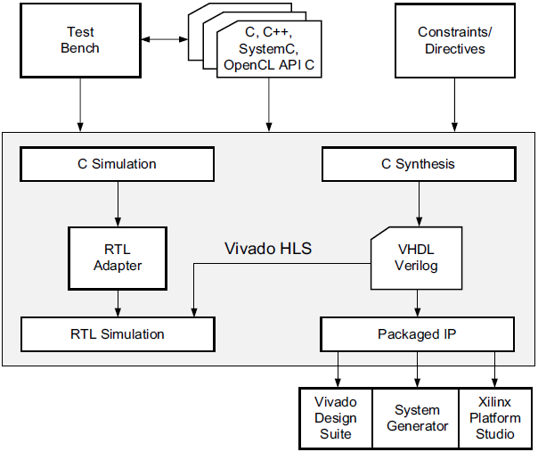
Why HLS?
Vivado HLS Design Flow

Slide 6
Optimizing the Design: Clock, Reset and RTL output

Slide 7
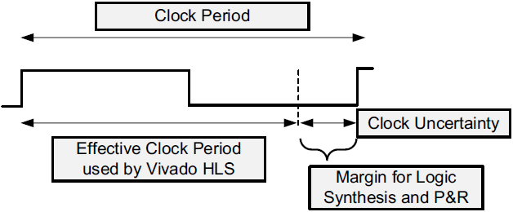
Optimizing the Design: Clock, Reset and RTL output
Specifying the Clock Frequency
For C and C++ designs only a single clock is supported.
For SystemC designs, each SC_MODULE may be specified with a different clock.
The clock period, in ns, is set in the Solutions > Solutions Setting. Vivado HLS uses the concept of a clock uncertainty to provide a user defined timing margin.

Slide 8
Optimizing the Design: Clock, Reset and RTL output
Specifying the Reset
The variables start with the same initial state as the C code. However, there is no way to force a return to this initial state. To return to their initial state the variables must be implemented with a reset.
The reset option has four settings:
none: No reset is added to the design.
control: This is the default and ensures all control registers are reset.
state: This option adds a reset to control registers plus any registers or memories derived from static and global variables in the C code.
all: This adds a reset to all registers and memories in the design.

Slide 9
Optimizing the Design: Clock, Reset and RTL output
RTL output
Various characteristics of the RTL output by Vivado HLS can be controlled using the config_rtl configuration.
Specify the type of FSM encoding used in the RTL state machines.(onehot is the default)
Add an arbitrary comment string, such as a copyright notice, to all RTL files using the -header option.
Specify a unique name with the prefix option which is added to all RTL output file names.
Force the RTL ports to use lower case names.

Slide 10
Optimizing the Design: Throughput

Slide 11
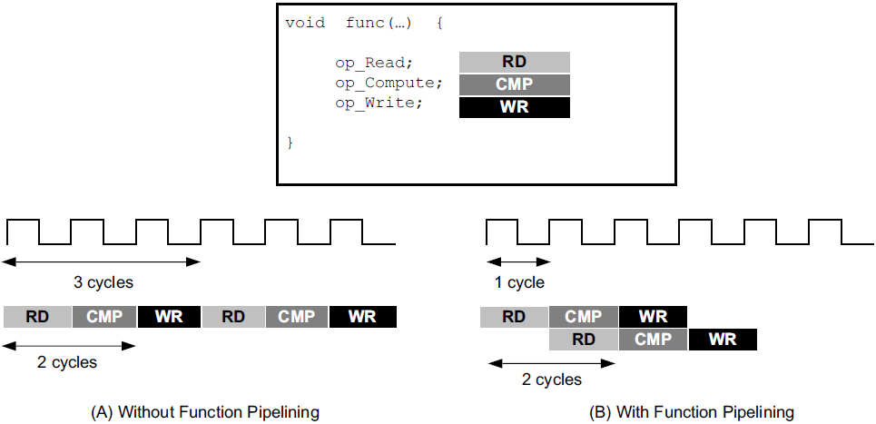
Optimizing the Design: Throughput
Function and Loop Pipelining
Pipelining allows operations to happen concurrently: the task does not have to complete all operations before it begin the next operation. Pipelining is applied to functions and loops.

Slide 12
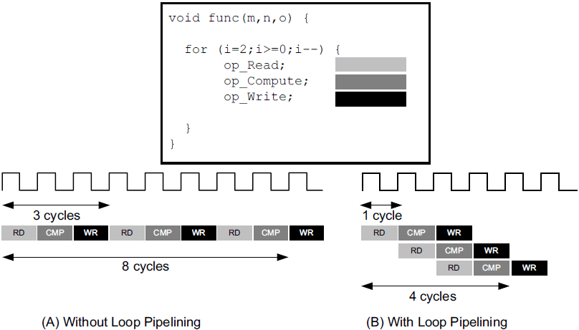
Optimizing the Design: Throughput
Function and Loop Pipelining
Loop pipelining allows the operations in a loop to be implemented in a concurrent manner as shown in the following figure.

Slide 13
Optimizing the Design: Throughput
Function and Loop Pipelining
Note: Pipelining is applied to the specified task not to the hierarchy below: all loops in the hierarchy below are automatically unrolled. Any sub-functions in the hierarchy below the specified task must be pipelined individually. If the sub-functions are pipelined, the pipelined tasks above it can take advantage of the pipeline performance.

Slide 14
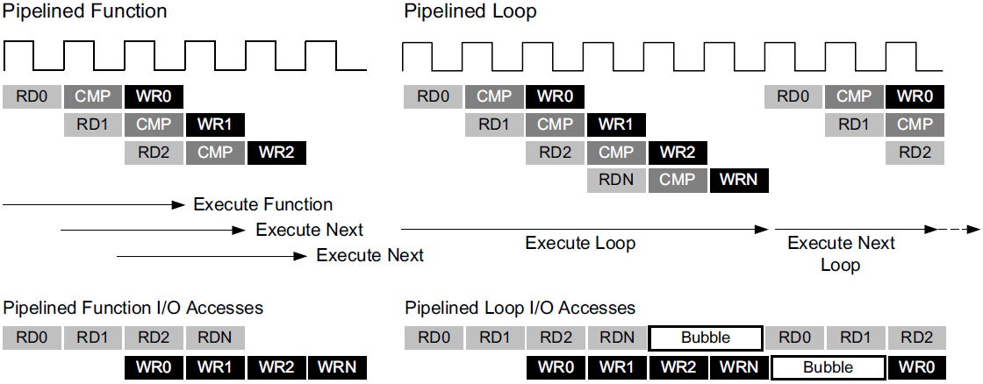
Optimizing the Design: Throughput
Function and Loop Pipelining
There is a difference in how pipelined functions and loops behave.
In the case of functions, the pipeline runs forever and never ends.
In the case of loops, the pipeline executes until all iterations of the loop are completed.
This difference in behavior is summarized in the following figure.

Slide 15
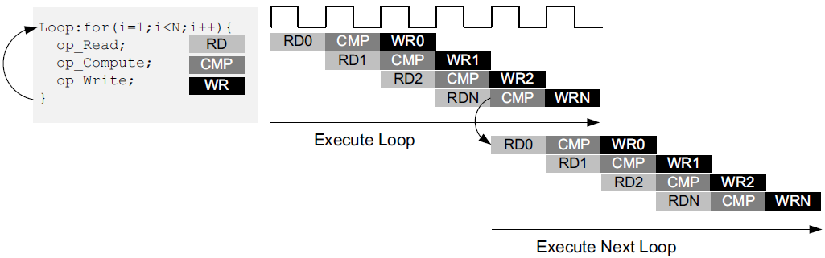
Optimizing the Design: Throughput
Rewinding Pipelined Loops
Loops which are the top-level loop in a function or are used in a region where the DATAFLOW optimization is used can be made to continuously execute using the PIPELINE directive with the rewind option.
Note: If the loop is used in a region with the DATAFLOW optimization, Vivado HLS automatically implements the loop as if it is in a function hierarchy.
Besides, The config_compile configuration enables loops to be pipelined automatically based on the iteration count.

Slide 16
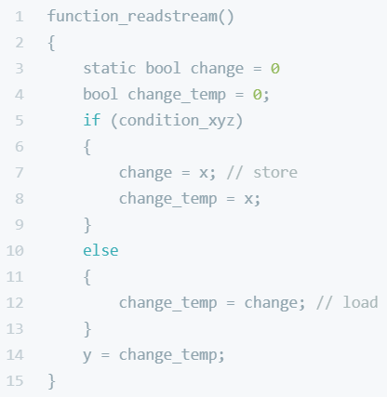
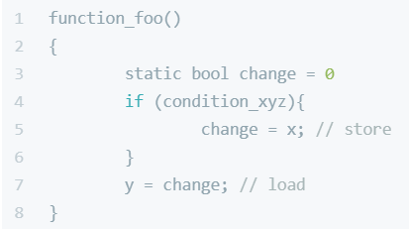
Optimizing the Design: Throughput
Addressing Failure to Pipeline
If a loop has variables bounds it cannot be unrolled. This will prevent the task from being pipelined.
Data dependency.

Slide 17
Optimizing the Design: Throughput
Partitioning Arrays
INFO: [SCHED 204-61] Pipelining loop 'SUM_LOOP'.
WARNING: [SCHED 204-69] Unable to schedule 'load' operation ('mem_load_2',
bottleneck.c:62) on array 'mem' due to limited memory ports.
WARNING: [SCHED 204-69] The resource limit of core:RAM:mem:p0 is 1, current
assignments:
WARNING: [SCHED 204-69] 'load' operation ('mem_load', bottleneck.c:62) on array
'mem',
WARNING: [SCHED 204-69] The resource limit of core:RAM:mem:p1 is 1, current
assignments:
WARNING: [SCHED 204-69] 'load' operation ('mem_load_1', bottleneck.c:62) on array 'mem',
INFO: [SCHED 204-61] Pipelining result: Target II: 1, Final II: 2, Depth: 3.

Slide 18
Optimizing the Design: Throughput
Partitioning Arrays
Arrays are implemented as block RAM which only has a maximum of two data ports. This can limit the throughput of a read/write (or load/store) intensive algorithm. The bandwidth can be improved by splitting the array (a single block RAM resource) into multiple smaller arrays (multiple block RAMs), effectively increasing the number of ports.
Flashback to the basic structure of FPGA: What’s the features of BRAM resource?

Slide 19
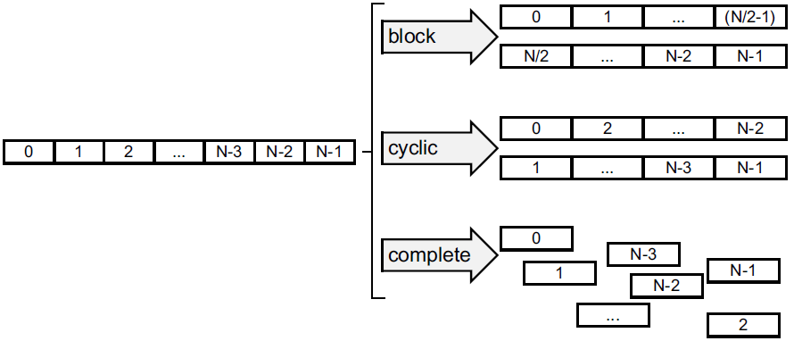
Optimizing the Design: Throughput
Partitioning Arrays
Arrays are partitioned using the ARRAY_PARTITION directive. Vivado HLS provides three types of array partitioning, as shown in the following figure. The three styles of partitioning are:
block: The original array is split into equally sized blocks of consecutive elements of the original array.
cyclic: The original array is split into equally sized blocks interleaving the elements of the original array.
complete: The default operation is to split the array into its individual elements. This corresponds to resolving a memory into registers.
For block and cyclic partitioning the factor option specifies the number of arrays that are created. In the preceding figure, a factor of 2 is used, that is, the array is divided into two smaller arrays.

Slide 20
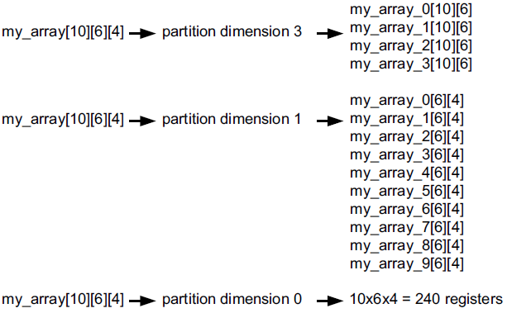
Optimizing the Design: Throughput
Partitioning Arrays
When partitioning multi-dimensional arrays, the dimension option is used to specify which dimension is partitioned.
Note: The config_array_partition configuration determines how arrays are automatically partitioned based on the number of elements.(Do not recommend)

Slide 21
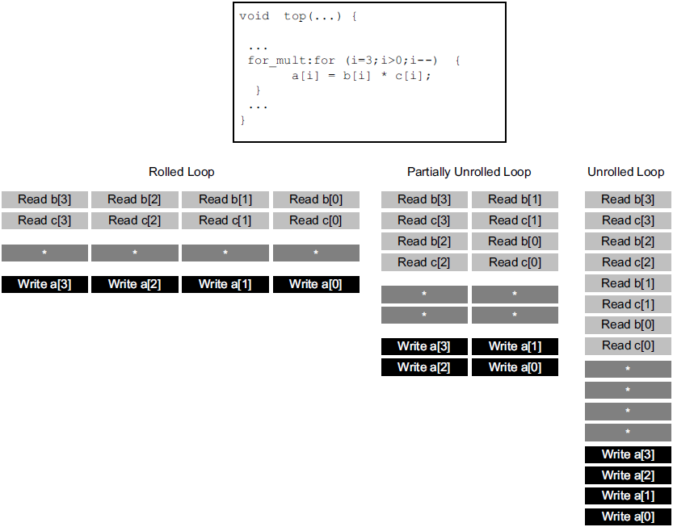
Optimizing the Design: Throughput
Optimal Loop Unrolling
Rolled Loop: When the loop is rolled, each iteration is performed in a separate clock cycle.
Partially Unrolled Loop: In this example, the loop is partially unrolled by a factor of 2.
Unrolled loop: In the fully unrolled version all loop operation can be performed in a single clock cycle.
Resource VS. Throughput

Slide 22
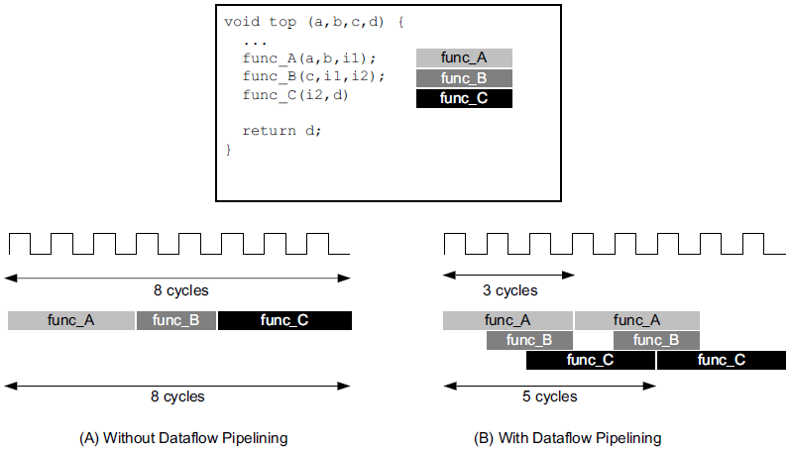
Optimizing the Design: Throughput
Task Level Pipelining: Dataflow Optimization
The following coding styles prevent Vivado HLS from performing the DATAFLOW optimization:
Single-producer-consumer violations
Bypassing tasks
Feedback between tasks
Conditional execution of tasks
Loops with multiple exit conditions

Slide 23
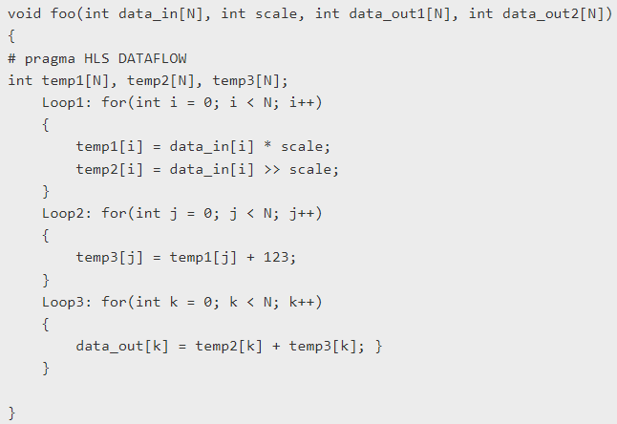
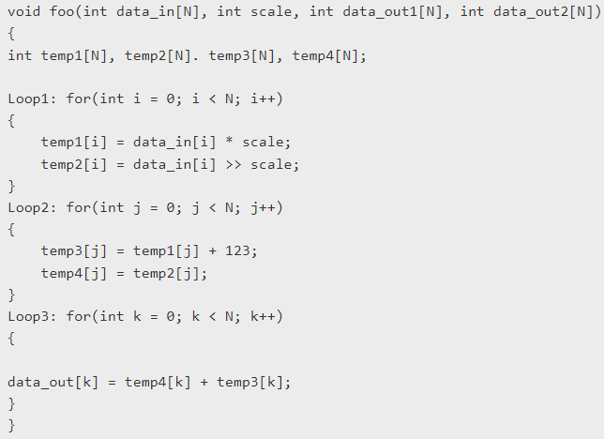
Optimizing the Design: Throughput
Task Level Pipelining: Dataflow Optimization
Bypassing tasks example and solution.
Copy Buffer.
Reference: Dataflow Bypassing Tasks

Slide 24
Optimizing the Design: Latency

Slide 25
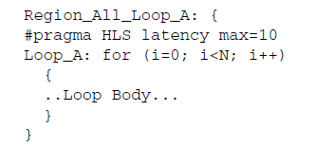
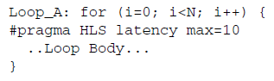
Optimizing the Design: Latency
Using Latency Constraints
VS.
Limit the required latency of a single iteration of the loop.
Limit the required total latency of all loop iterations.
Cannot meet the constraint?
If Vivado HLS cannot meet a maximum latency constraint it relaxes the latency constraint and tries to achieve the best possible result.
If a minimum latency constraint is set and Vivado HLS can produce a design with a lower latency than the minimum required it inserts dummy clock cycles to meet the minimum latency.

Slide 26
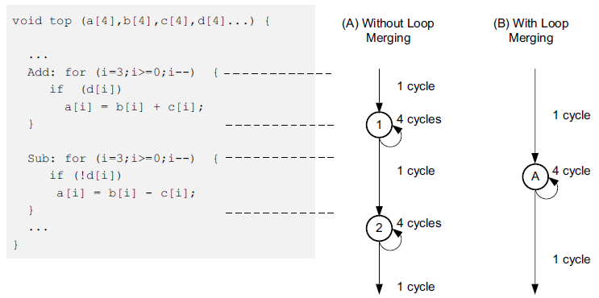
Optimizing the Design: Latency
Merging Sequential Loops to Reduce Latency
• 1 clock cycle to enter the ADD loop.
• 4 clock cycles to execute the add loop.
• 1 clock cycle to exit ADD and enter SUB.
• 4 clock cycles to execute the SUB loop.
• 1 clock cycle to exit the SUB loop.
• For a total of 11 clock cycles.
In this simple example it is obvious that an else branch in the ADD loop would also solve the issue.
The LOOP_MERGE optimization directive is used to automatically merge loops.

Slide 27
Optimizing the Design: Latency
Merging Sequential Loops to Reduce Latency
Merging loops allows the logic within the loops to be optimized together. In the example above, using a dual-port block RAM allows the add and subtraction operations to be performed in parallel.
loop merging in Vivado HLS has the following restrictions:
• If loop bounds are all variables, they must have the same value.
• If loops bounds are constants, the maximum constant value is used as the bound of the merged loop.
• Loops with both variable bound and constant bound cannot be merged.
• The code between loops to be merged cannot have side effects: multiple execution of this code should generate the same results (a=b is allowed, a=a+1 is not).
• Loops cannot be merged when they contain FIFO accesses: merging would change the order of the reads and writes from a FIFO: these must always occur in sequence.

Slide 28
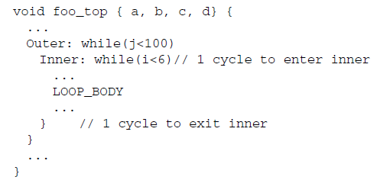
Optimizing the Design: Latency
Flattening Nested Loops
Vivado HLS provides the set_directive_loop_flatten command to allow labeled perfect and semi-perfect nested loops to be flattened.
Perfect loop nest: only the innermost loop has loop body content, there is no logic specified between the loop statements and all the loop bounds are constant.
Semi-perfect loop nest: only the innermost loop has loop body content, there is no logic specified between the loop statements but the outermost loop bound can be a variable.
It requires one clock cycle to move from an outer loop to an inner loop and from an inner loop to an outer loop.
200 extra clock cycles

Slide 29
Optimizing the Design: Area

Slide 30
Optimizing the Design: Area
Data Types and Bit-Widths
int a; VS. ap_int<5> a;
The bit-widths of the variables in the C function directly impact the size of the storage elements and operators used in the RTL implementation.
Use the appropriate precision for the data types.
Confirm the size of any arrays that are to be implemented as RAMs or registers. The area impact of any over-sized elements is wasteful in hardware resources.
Pay special attention to multiplications, divisions, modulus or other complex arithmetic operations. If these variables are larger than they need to be, they negatively impact both area and performance.

Slide 31
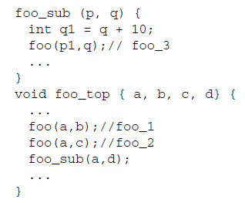
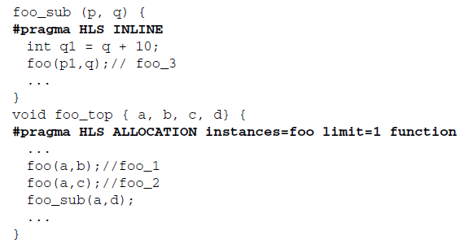
Optimizing the Design: Area
Function Inlining
Inlining a function may improve area by allowing the components within the function to be better shared or optimized with the logic in the calling function.
Inlining function foo_sub and using the ALLOCATION directive to specify only 1 instance of function foo is used, results in a design which only has one instance of function foo: one-third the area of the example left.

Slide 32
Optimizing the Design: Area
Mapping Many Arrays into One Large Array
When there are many small arrays in the C Code, mapping them into a single larger array typically reduces the number of block RAM required.
The ARRAY_MAP directive supports two ways of mapping small arrays into a larger one:
Horizontal mapping: this corresponds to creating a new array by concatenating the original arrays. Physically, this gets implemented as a single array with more elements.
Vertical mapping: this corresponds to creating a new array by concatenating the original words in the array. Physically, this gets implemented by a single array with a larger bit-width.

Slide 33
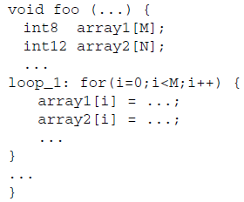
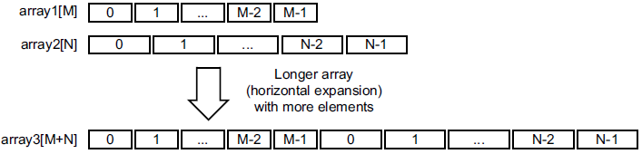
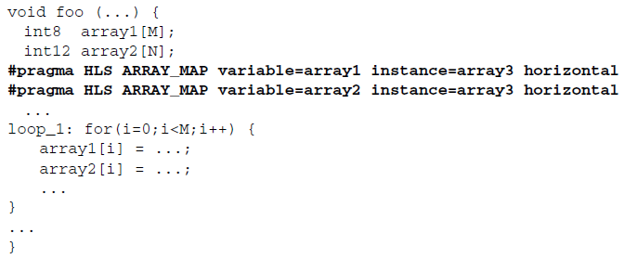
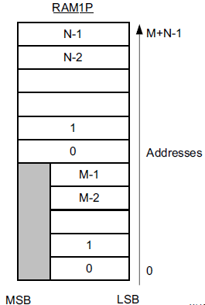
Optimizing the Design: Area
Mapping Many Arrays into One Large Array: Horizontal mapping

Slide 34
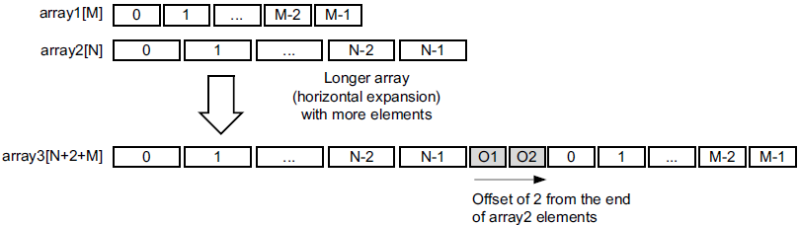
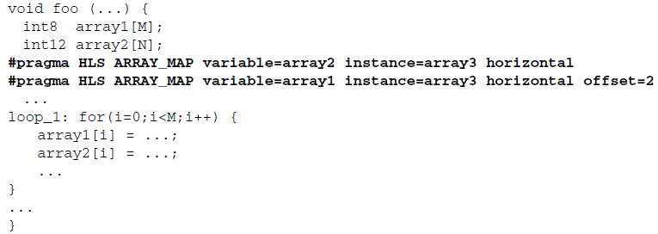
Optimizing the Design: Area
Mapping Many Arrays into One Large Array: Horizontal mapping

Slide 35
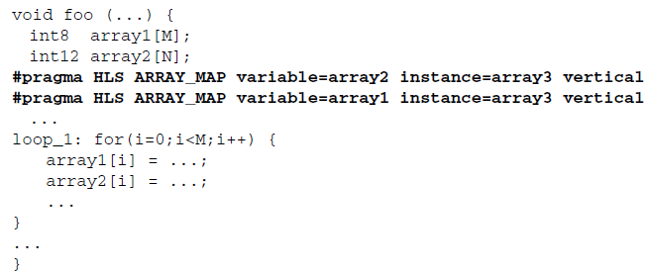
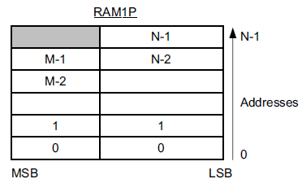
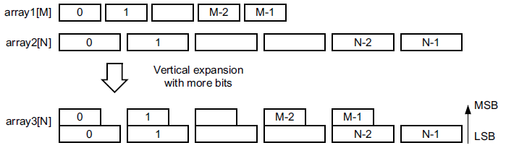
Optimizing the Design: Area
Mapping Many Arrays into One Large Array: Vertical mapping
In vertical mapping, arrays are concatenated by to produce an array with higher bit-widths.

Slide 36
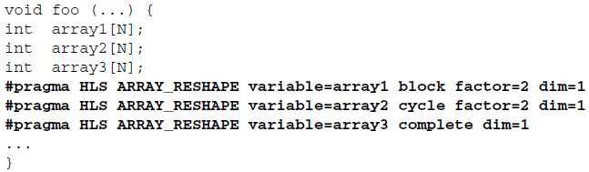
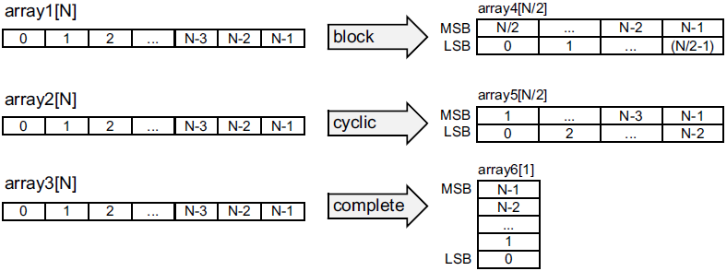
Optimizing the Design: Area
Array Reshaping
The ARRAY_RESHAPE directive allows more data to be accessed in a single clock cycle. In cases where more data can be accessed in a single clock cycle.
Q: What’s the difference between Array Reshaping and Array Partitioning?

Slide 37
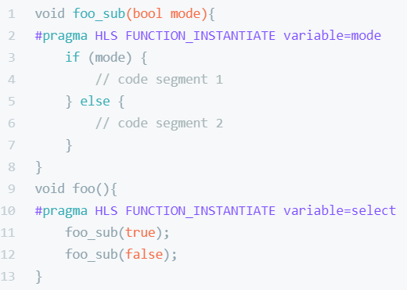
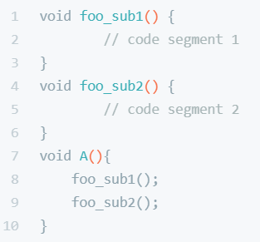
Optimizing the Design: Area
Function Instantiation
Function instantiation is an optimization technique that has the area benefits of maintaining the function hierarchy but provides an additional powerful option: performing targeted local optimizations on specific instances of a function.
The FUNCTION_INSTANTIATE optimization allows each instance to be independently optimized, reducing the functionality and area.

Slide 38
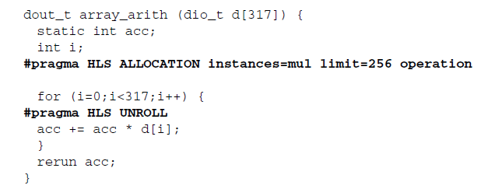
Optimizing the Design: Area
Limiting the Number of Operators
Limiting the number of operators in a design is a useful technique to reduce the area: it helps reduce area by forcing sharing of the operations. The ALLOCATION directive allows you to limit how many operators, or cores or functions are used in a design.
The ALLOCATION directive, like all directives, is specified inside a scope: a function, a loop or a region. The config_bind configuration allows the operators to be minimized throughout the entire design.

Slide 39
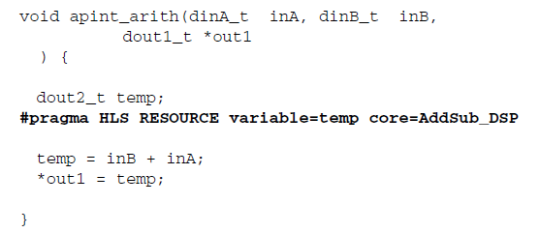
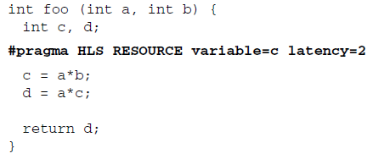
Optimizing the Design: Area
Controlling the Hardware Cores
When synthesis is performed, Vivado HLS uses the timing constraints specified by the clock, the delays specified by the target device together with any directives specified by you, to determine which core is used to implement the operators.
This ensures that the operation is implemented using a DSP48 primitive in the final design - by default, add operations are implemented using LUTs.

Slide 40
Optimizing the Design: Area
Globally Optimizing Hardware Cores
The config_bind configuration provides control over the binding process. The configuration allows you to direct how much effort is spent when binding cores to operators.
config_bind -effort [low | medium | high] -min_op <list>
Low Effort: Spend less timing sharing, run time is faster but the final RTL may be larger. Useful for cases when the designer knows there is little sharing possible or desirable and does not wish to waste CPU cycles exploring possibilities.
Medium Effort: The default, where Vivado HLS tries to share operations but endeavors to finish in a reasonable time.
High Effort: Try to maximize sharing and do not limit run time. Vivado HLS keeps trying until all possible combinations of sharing is explored.

Slide 41
Optimizing the Design: Logic

Slide 42
Optimizing the Design: Logic
Controlling Operator Pipelining
RTL synthesis might use the additional pipeline registers to help improve timing issues that might result after place and route.
config_core DSP48 -latency 4
config_core RAM_1P_BRAM -latency 3
The rules for adding these additional pipeline stages are:
If the latency is specified as 1 cycle more than the latency decided by Vivado HLS, Vivado HLS adds new output registers to the output of the operation.
If the latency is specified as 2 more than the latency decided by Vivado HLS, Vivado HLS adds registers to the output of the operation and to the input side of the operation.
If the latency is specified as 3 or more cycles than the latency decided by Vivado HLS, Vivado HLS adds registers to the output of the operation and to the input side of the operation. Vivado HLS automatically determines the location of any additional registers.

Slide 43
Optimizing the Design: Logic
Optimizing Logic Expressions
During synthesis several optimizations, such as strength reduction and bit-width minimization are performed. Included in the list of automatic optimizations is expression balancing.
Note: strength reduction is a optimization where expensive operations are replaced with equivalent but less expensive operations.
Expression balancing rearranges operators to construct a balanced tree and reduce latency.
For integer operations expression balancing is on by default but may be disabled.
For floating-point operations, expression balancing is off by default but may be enabled.

Slide 44
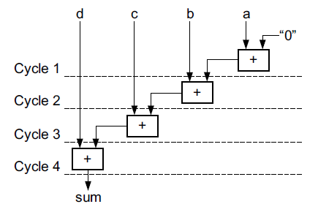
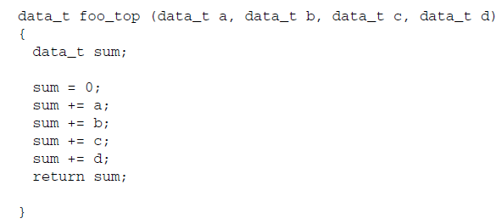
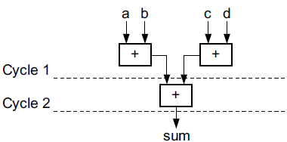
Optimizing the Design: Logic
Optimizing Logic Expressions

Slide 45
Managing Interfaces: Overview

Slide 46
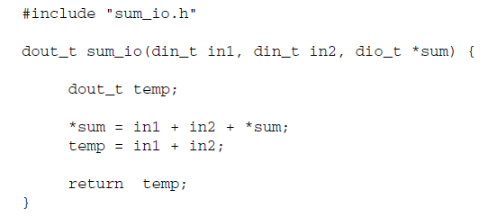
Managing Interfaces: Overview
Two pass-by-value inputs in1 and in2.
A pointer sum that is both read from and written to.
A function return, the value of temp.
Clock and Reset ports: ap_clk and ap_rst. (If the design takes more than 1 cycle to complete operation.)
Block-Level interface protocol: ap_start, ap_done, ap_ready, and ap_idle.
Port Level interface protocols: in1, in2, sum_i, sum_o, sum_o_ap_vld, and ap_return.

Slide 47
Managing Interfaces: Overview
By default, a block-level interface protocol is added to the design. These signal control the block, independently of any port-level I/O protocols. These ports control when the block can start processing data (ap_start), indicate when it is ready to accept new inputs (ap_ready) and indicate if the design is idle (ap_idle) or has completed operation (ap_done).

Slide 48
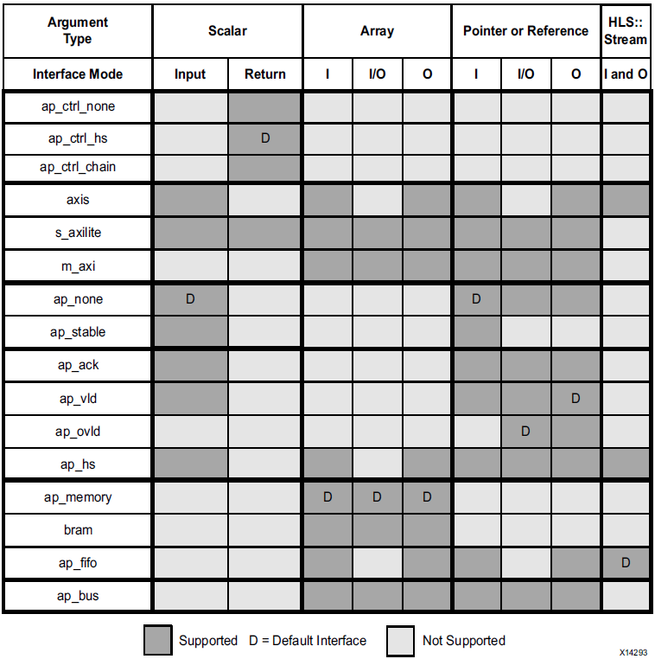
Managing Interfaces: Data Type and Interface Synthesis Support

Slide 49
Managing Interfaces: Block-Level Interface Protocols
The block-level interface protocols are ap_ctrl_none, ap_ctrl_hs, and ap_ctrl_chain. These are specified, and can only be specified, on the function or the function return.
ap_ctrl_hs:The ap_ctrl_hs mode described in the previous example is the default protocol.
ap_ctrl_chain: The ap_ctrl_chain protocol is similar to ap_ctrl_hs but has an additional input port ap_continue which provides back pressure from blocks consuming the data from this block.
ap_ctrl_none: The ap_ctrl_none mode implements the design without any block-level I/O protocol.
Note: If the function return is also specified as an AXI4-Lite interface (s_axilite) all the ports in the block-level interface are grouped into the AXI4-Lite interface.

Slide 50
Interface Synthesis Reference(optional)

Slide 51
Interface Synthesis Reference: Block-Level IO Protocol
ap_ctrl_hs

Slide 52
Interface Synthesis Reference: Block-Level IO Protocol
ap_ctrl_chain

Slide 53
Interface Synthesis Reference: Port-Level IO Protocol
ap_hs(ap_ack,ap_vld,ap_ovld)

Slide 54
Interface Synthesis Reference: Port-Level IO Protocol
ap_memory

Slide 55
Interface Synthesis Reference: Port-Level IO Protocol
ap_fifo

Slide 56
Interface Synthesis Reference: Port-Level IO Protocol
ap_bus:Standard Read

Slide 57
Interface Synthesis Reference: Port-Level IO Protocol
ap_bus:Standard Write

Slide 58
Interface Synthesis Reference: Port-Level IO Protocol
ap_bus:Brust Read

Slide 59
Interface Synthesis Reference: Port-Level IO Protocol
ap_bus:Brust Write

Slide 60
How to use HLS?

Slide 61
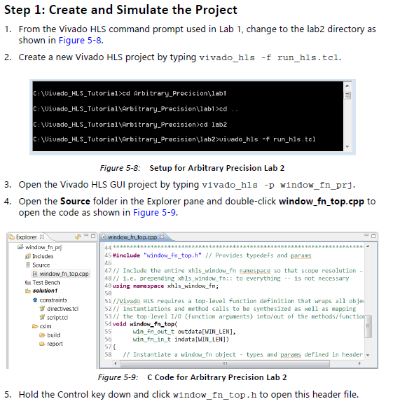
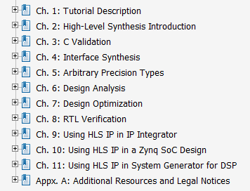
How to use HLS?
UG871

Slide 62
What’s more?

Slide 63
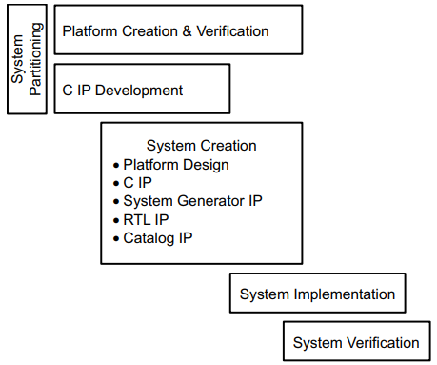
What’s more?
High-Level Synthesis C Libraries: HLS Stream Library, HLS Math Library, HLS Video Library, etc.
High-Level Productivity Design Methodology

Slide 64
Reference
UG902-Vivado Design Suite User Guide: High-Level Synthesis
UG871-Vivado Design Suite Tutorial: High-Level Synthesis
UG1197-UltraFast Vivado HLS Methodology Guide

Slide 65
Thanks!

